Slide 1

ITU Forum on Internet of Things: A New Age of Smarter Living 18th January 2016 Singapore
IoT Meets Big Data
Standardization Considerations
Sekhar Kondepudi Ph.D.
Associate Professor
Director, Smart Buildings, Smart Cities & IoT Lab

Slide 2
IoT
The IoT is expanding the sensory capabilities for all products by providing visibility into the field and usage patterns, unleashing transformative opportunities for the entire ecosystem of caregivers, patients, payers, medical devices and pharmaceuticals companies.
The lack of standards, a crowded product landscape and the relatively nascent stage of technology compel medical device companies to carefully craft their IoT strategies.

Slide 3
Big Data
extremely large data sets that may be analyzed computationally to reveal patterns, trends, and associations, especially relating to human behavior and interactions.
"much IT investment is going towards managing and maintaining big data"

Slide 4
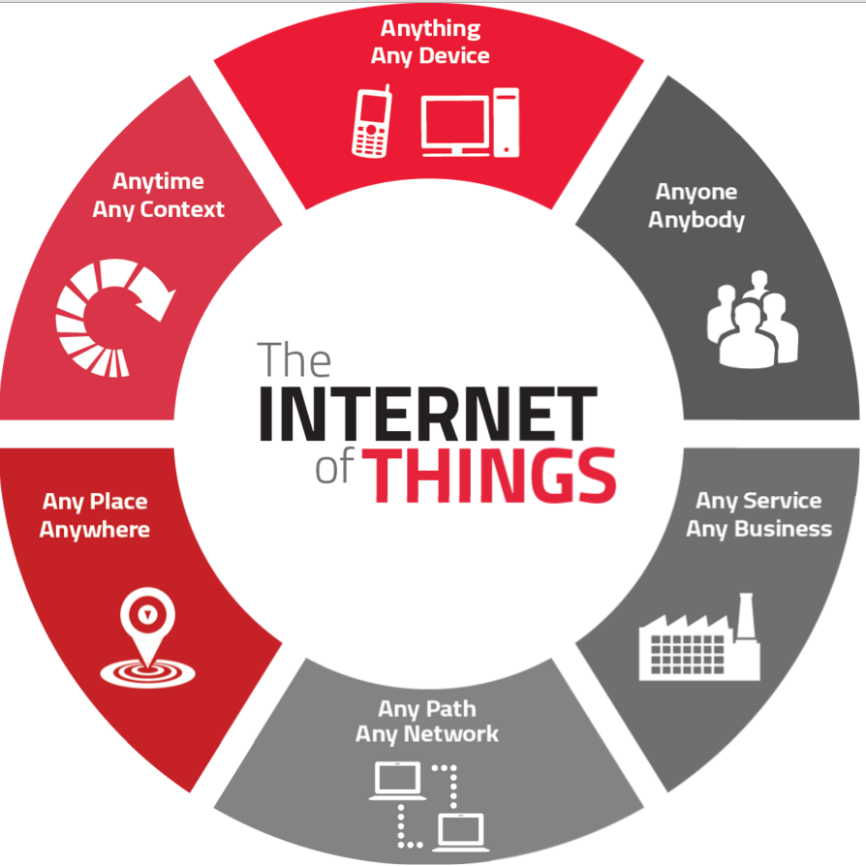
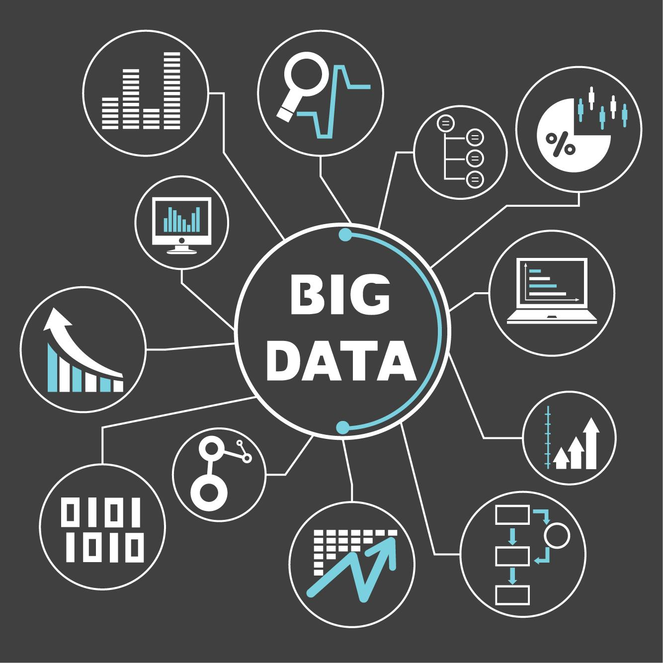
IoT Meets Big Data

Slide 5
Major advantages IoT to healthcare organizations
Decreased Costs: When healthcare providers take advantage of the connectivity of the healthcare solutions, patient monitoring can be done on a real time basis, thus significantly cutting down on unnecessary visits by doctors. In particular, home care facilities that are advanced are guaranteed to cut down on hospital stays and re-admissions.
Improved Outcomes of Treatment: Connectivity of health care solutions through cloud computing or other virtual infrastructure gives caregivers the ability to access real time information that enables them to make informed decisions as well as offer treatment that is evidence based. This ensures health care provision is timely and treatment outcomes are improved.
Improved Disease Management: When patients are monitored on a continuous basis and health care providers are able to access real time data, diseases are treated before they get out of hand.
Reduced Errors: Accurate collection of data, automated workflows combined with data driven decisions are an excellent way of cutting down on waste, reducing system costs and most importantly minimizing on errors.
Enhanced Patient Experience: The connectivity of the health care system through the internet of things, places emphasis on the needs of the patient. That is, proactive treatments, improved accuracy when it comes to diagnosis, timely intervention by physicians and enhanced treatment outcomes result in accountable care that is highly trusted among patients.
Enhanced Management of Drugs: Creation as well as management of drugs is a major expense in the healthcare industry. Even then, with IoT processes and devices, it is possible to manage these costs better.
Notes:
Decreased Costs: When healthcare providers take advantage of the connectivity of the healthcare solutions, patient monitoring can be done on a real time basis, thus significantly cutting down on unnecessary visits by doctors. In particular, home care facilities that are advanced are guaranteed to cut down on hospital stays and re-admissions.
Improved Outcomes of Treatment: Connectivity of health care solutions through cloud computing or other virtual infrastructure gives caregivers the ability to access real time information that enables them to make informed decisions as well as offer treatment that is evidence based. This ensures health care provision is timely and treatment outcomes are improved.
Improved Disease Management: When patients are monitored on a continuous basis and health care providers are able to access real time data, diseases are treated before they get out of hand.
Reduced Errors: Accurate collection of data, automated workflows combined with data driven decisions are an excellent way of cutting down on waste, reducing system costs and most importantly minimizing on errors.
Enhanced Patient Experience: The connectivity of the health care system through the internet of things, places emphasis on the needs of the patient. That is, proactive treatments, improved accuracy when it comes to diagnosis, timely intervention by physicians and enhanced treatment outcomes result in accountable care that is highly trusted among patients.
Enhanced Management of Drugs: Creation as well as management of drugs is a major expense in the healthcare industry. Even then, with IoT processes and devices, it is possible to manage these costs better.

Slide 6
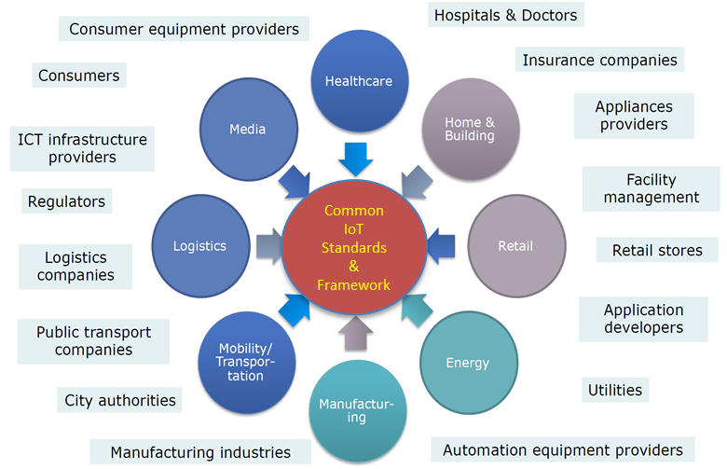
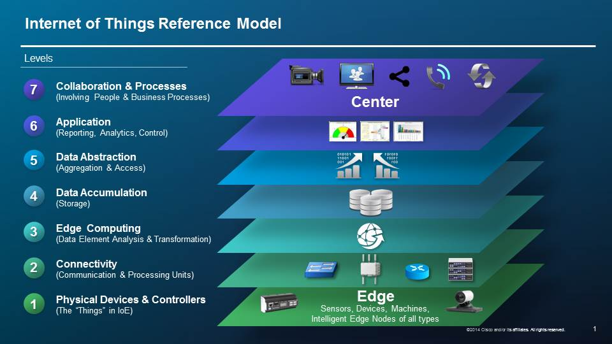
Data is Integral to IoT
2

Slide 7
Survey of the Use of IoT
200 technology and business professionals responsible for IoT projects.
The goal of the survey was to understand experiences and impacts of using the data captured by the devices that make up the Internet of Things and focused on the untapped potential of IoT data.
Use of IoT for Business Optimization
53 per cent are using IoT projects to optimise existing businesses and 47 percent as a strategic business investment
Target audiences for IoT solutions include consumers (42 percent), business (54 percent) and internal use by employees (51 percent)
Challenges with IoT Projects
96 per cent have faced challenges with their IoT projects
IoT Is Not Delivering Full Potential Because Of Data Challenges
Only 8 per cent are fully capturing and analysing IoT data in a timely fashion
86 per cent of stakeholders in business roles say data is important to their IoT project
94 per cent face challenges collecting and analysing IoT data
Better IoT Data Collection And Analysis Would Deliver More Value
70 per cent say they would make better, more meaningful decisions with improved data
86 per cent report that faster and more flexible analytics would increase the ROI of their IoT investments
Source : PARSTREAM

Slide 8
IoT & Data Challenges
44% said that there was too much data to analyze effectively
36% said that it was difficult to capture data in the first place,
25% saying data was not captured reliably
19% saying that data was captured too slowly to be useful.
Once data is captured, 27% said they weren’t sure what to use it for and were unsure what questions to ask.
Much like data capture, 26% said that the analysis process was too slow to be actionable,
24% said that business processes were too rigid to allow them to act on their findings – even if they were captured and crunched in time to be useful.
While cost is often a limiting factor in many technology decisions, for IoT stakeholders, ease of use appears to be a more pressing issue than cost.
More participants (76%) say they would collect and store more data if it were easier than those who said they would collect and store additional data if it were free.”
Source : PARSTREAM

Slide 9
Big Data Value Chain
Collection
Ingestion
Discovery & Cleansing
Integration
Analysis
Delivery
Collection – Structured, unstructured and semi-structured data from multiple sources
Ingestion – loading vast amounts of data onto a single data store
Discovery & Cleansing – understanding format and content; clean up and formatting
Integration – linking, entity extraction, entity resolution, indexing and data fusion
Analysis – Intelligence, statistics, predictive and text analytics, machine learning
Delivery – querying, visualization, real time delivery on enterprise-class availability
Need for Standardized Approaches At Each Step
12
9

Slide 10
Generalized Approach to Standardization
Definitions & Taxonomies
Requirements & Use Case
Security & Privacy
Reference Architecture
Technology Roadmap

Slide 11
Considerations for Big Data Standardization
Variety of Use Cases
Mobility
Security & Privacy
Lifecycle Management & Data Quality
System Management & Other Issues
Data Characteristics
Distributed / Centralized
The 4 Vs : Volume, Velocity, Variety, Veracity
Data Collection
Data Visualization
Data Quality
Data Analytics & Action

Slide 12
Data Sources
Source
Any*
Sensors
Applications
Software agents
Individuals
Organizations
Hardware resources
Anytime
Anything
Any Device
Any Context
Any Place
Anywhere
Any one

Slide 13
Big Data Standardization Challenges (1)
Big Data use cases, definitions, vocabulary and reference architectures (e.g. system, data, platforms, online/offline)
Specifications and standardization of metadata including data provenance
Application models (e.g. batch, streaming)
Query languages including non-relational queries to support diverse data types (XML, RDF, JSON, multimedia) and Big Data operations (e.g. matrix operations)
Domain-specific languages
Semantics of eventual consistency
Advanced network protocols for efficient data transfer
General and domain specific ontologies and taxonomies for describing data semantics including interoperation between ontologies
Source : ISO

Slide 14
Big Data Standardization Challenges (2)
Big Data security and privacy access controls
Remote, distributed, and federated analytics (taking the analytics to the data) including data and processing resource discovery and data mining
Data sharing and exchange
Data storage, e.g. memory storage system, distributed file system, data warehouse, etc.
Human consumption of the results of big data analysis (e.g. visualization)
Interface between relational (SQL) and non-relational (NoSQL)
Big Data Quality and Veracity description and management
Source : ISO

Slide 15
Big Data or IoT ?
Every minute, we send 204 million emails, generate 1.8 million Facebook likes, send 278 thousand tweets, and upload 200 thousand photos to Facebook. (BIG DATA or IoT )
12 million RFID tags (used to capture data and track movement of objects in the physical world) were sold in 2011. By 2021, it’s estimated this number will increase to 209 billion as (BIG DATA or IoT ) takes off.
The boom of (BIG DATA or IoT) will mean that the amount of devices that connect to the internet will rise from about 13 billion today to 50 billion by 2020.
The (BIG DATA or IoT ) industry is expected to grow from US$10.2 billion in 2013 to about US$54.3 billion by 2017.
Every minute, we send 204 million emails, generate 1.8 million Facebook likes, send 278 thousand tweets, and upload 200 thousand photos to Facebook. (BIG DATA or IoT )
12 million RFID tags (used to capture data and track movement of objects in the physical world) were sold in 2011. By 2021, it’s estimated this number will increase to 209 billion as (BIG DATA or IoT ) takes off.
The boom of (BIG DATA or IoT) will mean that the amount of devices that connect to the internet will rise from about 13 billion today to 50 billion by 2020.
The (BIG DATA or IoT ) industry is expected to grow from US$10.2 billion in 2013 to about US$54.3 billion by 2017.

Slide 16
Big data sample
OpenfMRI.org is a project dedicated to the free and open sharing of raw magnetic resonance imaging (MRI) datasets. Number of currently avaliable datasets: 63 Number of subjects across all datasets: 2158 https://openfmri.org/dataset/ds000105/

Slide 17
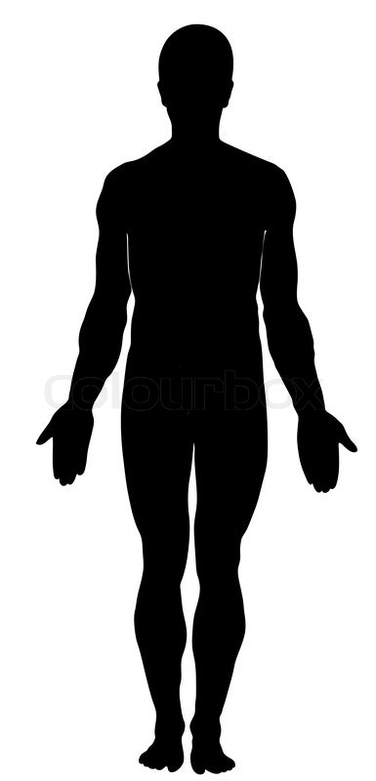
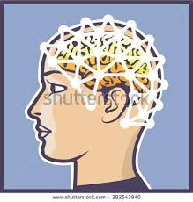

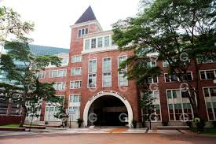




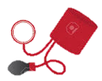
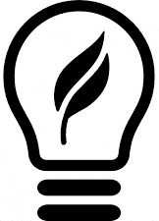
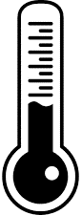
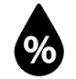

Controlled class room
IoT in Healthcare sample
UPH campus
Body sensor
EEG
sensor
Controlled
A/C
Temperature
sensor
Camera
sensor
Controlled
Light
ECG / HR
sensor
Air Quality
sensor
BP
sensor
stress
sensor
Light
sensor
Humidity
sensor
Temperature
sensor
Noise
sensor
Temperature
sensor
fatigue
sensor
1. Physical health
2. Environment health
3. Social / Mental health
Smart health in campus

Slide 18
